Slide 1
Environment Variables
&
Attacks

Slide 2
Environment Variables
  A set of dynamic named values
  Part of the operating environment in which a process runs
  Affect the way that a running process will behave
  Introduced in Unix and also adopted by Microsoft Windows
  Example: PATH variable
    When a program is executed the shell process will use the environment variable to find where the program is, if the full path is not provided.
Notes:
Define what environment variables are

Slide 3
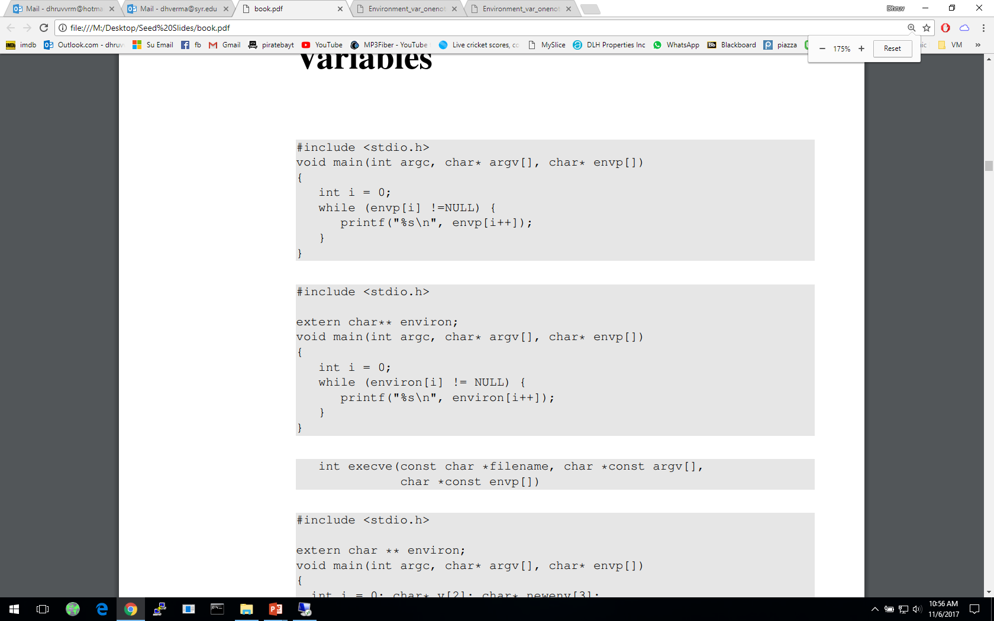
How to Access Environment Variables
From the main function
More reliable way:
Using the global variable
Notes:
Ways of accessing environment variables
envp[] and environ
Recommended approach is to use environ – reason explained in following slides

Slide 4
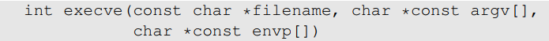
How Does a process get Environment Variables?
Process can get environment variables one of two ways:
  If a new process is created using fork() system call, the child process will inherits its parent process’s environment variables.
  If a process runs a new program in itself, it typically uses execve() system call. In this scenario, the memory space is overwritten and all old environment variables are lost. execve() can be invoked in a special manner to pass environment variables from one process to another.
Passing environment variables when invoking execve() :
Notes:
Getting environment variables
3rd argument in execve() system call

Slide 5
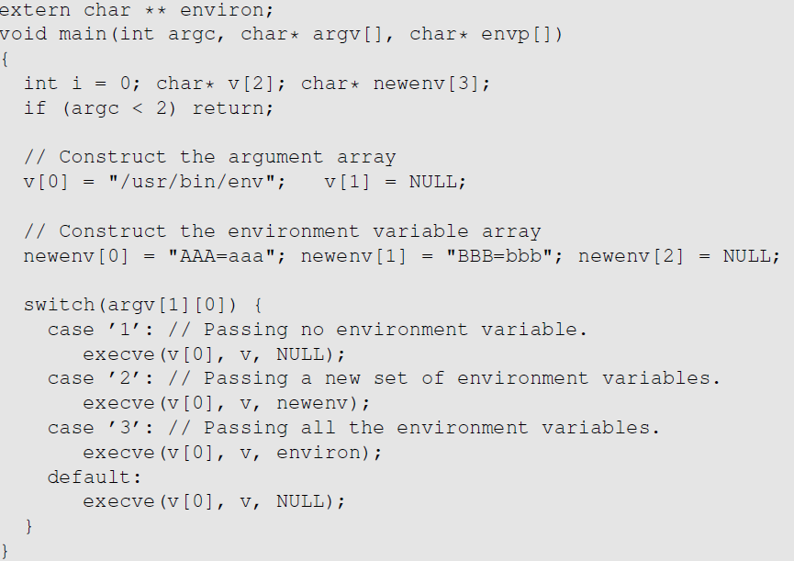
execve() and Environment variables
The program executes a new program /usr/bin/env, which prints out the environment variables of the current process.
We construct a new variable newenv, and use it as the 3rd argument.

Slide 6
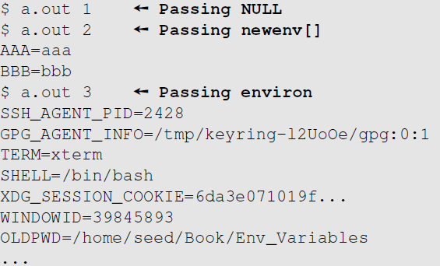
execve() and Environment variables
Obtained from the parent process
Notes:
Getting environment variables
3rd argument in execve() system call

Slide 7
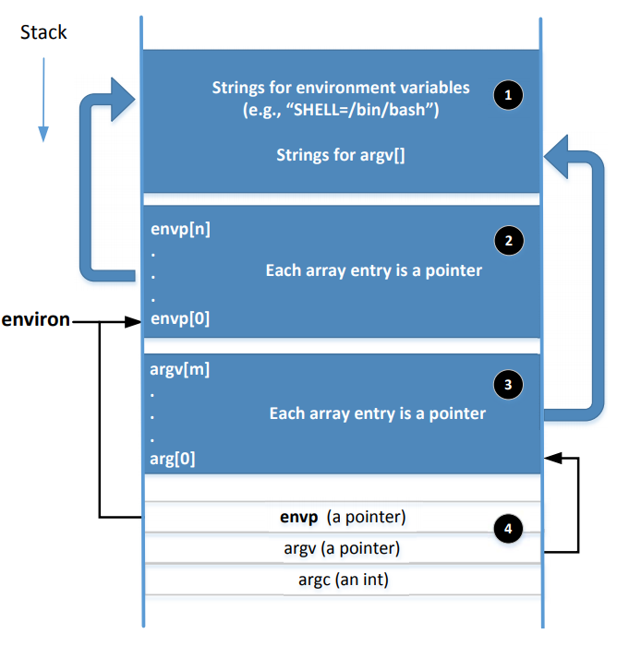
Memory Location for Environment Variables
envp and environ points to the same place initially.
envp is only accessible inside the main function, while environ is a global variable.
When changes are made to the environment variables (e.g., new ones are added), the location for storing the environment variables may be moved to the heap, so environ will change (envp does not change)
Notes:
Adding or deleting environment variables or modifying the value of existing one, there not be enough space in 1 & 2. In this case, the entire environment variable block may change to a different location (usually in the heap)
When this change happens, the environ variable should be changed accordingly
A program can change their environment variables using putenv(), setenv() etc

Slide 8
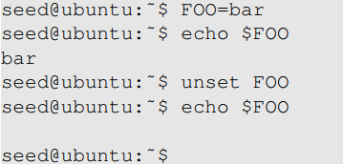
Shell Variables & Environment Variables
People often mistake shell variables and environment variables to be the same.
Shell Variables:
  Internal variables used by shell.
  Shell provides built-in commands to allow users to create, assign and delete shell variables.
  In the example, we create a shell variable called FOO.

Slide 9
Side Note on The /proc File System
/proc is a virtual file system in linux. It contains a directory for each process, using the process ID as the name of the directory
Each process directory has a virtual file called environ, which contains the environment of the process.
  e.g., virtual file /proc/932/environ contains the environment variable of process 932
  The command “strings /proc/$$/environ” prints out the environment variable of the current process (shell will replace $$ with its own process ID)
When env program is invoked in a bash shell, it runs in a child process. Therefore, it print out the environment variables of the shell’s child process, not its own.

Slide 10
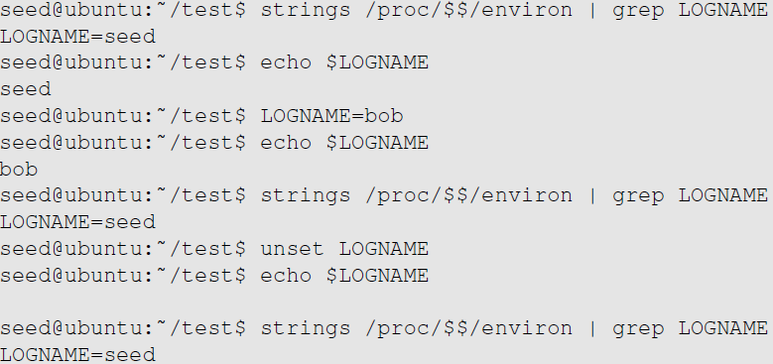
Shell Variables & Environment Variables
Shell variables and environment variables are different
When a shell program starts, it copies the environment variables into its own shell variables. Changes made to the shell variable will not reflect on the environment variables, as shown in example :
Environment variable
Shell variable
Shell variable is changed
Environment variable is the same
Shell variable is gone
Environment variable is still here
Notes:
Explain /proc/$$/environ: $$ will be replaced by the shell with the current process’s ID, so /proc/$$/environ basically contains the environment variables of the current process.

Slide 11
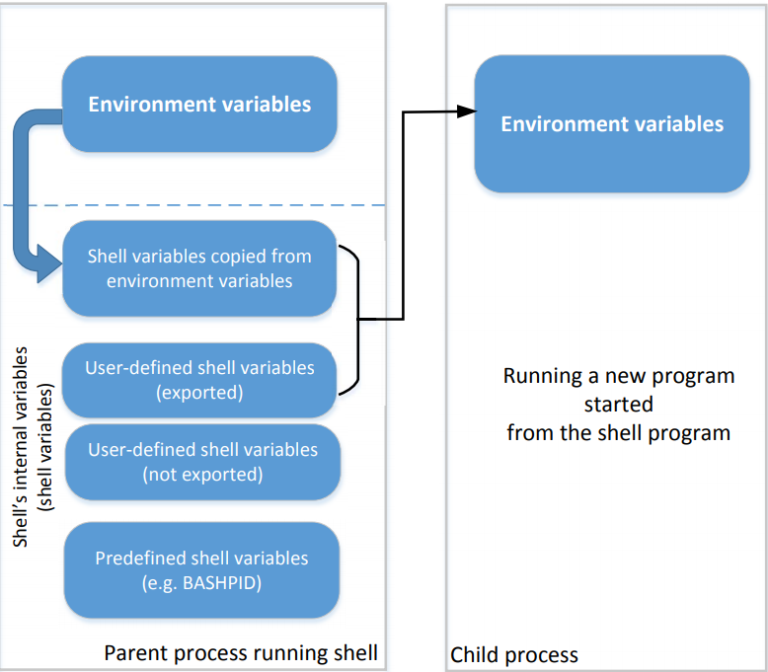
Shell Variables & Environment Variables
This figure shows how shell variables affect the environment variables of child processes
It also shows how the parent shell’s environment variables becomes the child process’s environment variables (via shell variables)
Notes:
How do shell variables become environment variables and why?
Fork()
Execve()
Which type of shell variables become the new environment variables?
Shell variables copied from environment variables
User defined shell variables using “export”
Example in next slide

Slide 12
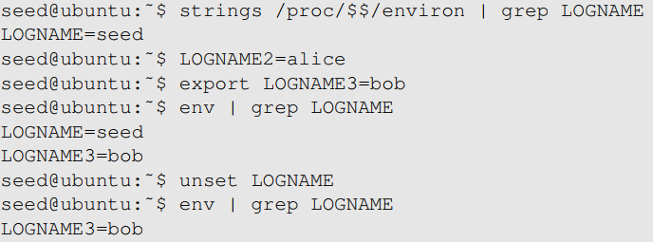
Shell Variables & Environment Variables
When we type env in shell prompt, shell will create a child process
Print out environment variable
Only LOGNAME and LOGNAME3 get into the child process, but not LOGNAME2. Why?
Notes:
Reason behind only LOGNAME and LOGNAME3 being printing
Unset function
How env is run as a child process is in next slide.

Slide 13
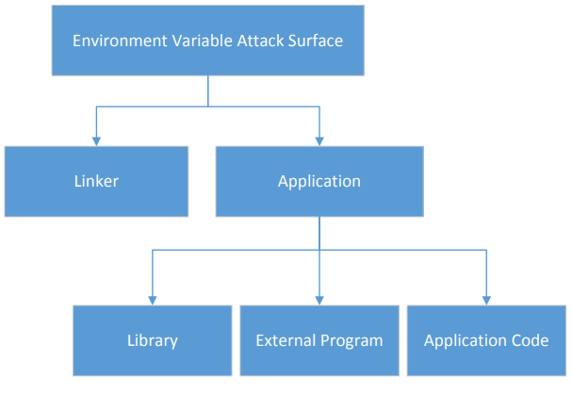
Attack Surface on Environment Variables
Hidden usage of environment variables is dangerous.
Since users can set environment variables, they become part of the attack surface on Set-UID programs.
Notes:
Overview of each of the parts and what they do
Linker
Library
External program
Application code

Slide 14
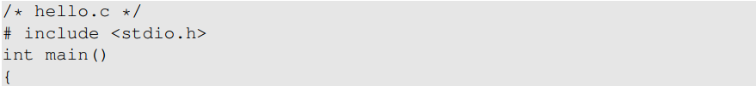
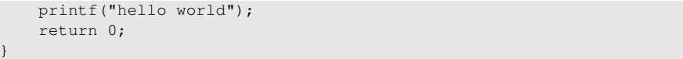
Attacks via Dynamic Linker
Linking finds the external library code referenced in the program
Linking can be done during runtime or compile time:
  Dynamic Linking – uses environment variables, which becomes part of the attack surface
  Static Linking
We will use the following example to differentiate static and dynamic linking:

Slide 15
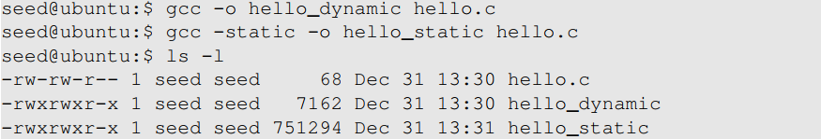
Attacks via Dynamic Linker
Static Linking
The linker combines the program’s code and the library code containing the printf() function
We can notice that the size of a static compiled program is 100 times larger than a dynamic program
Notes:
Static linking copies code and wastes a lot of memory
In time of a security path, everything will have to patched manually
Hence, dynamic linking is the recommended approach

Slide 16
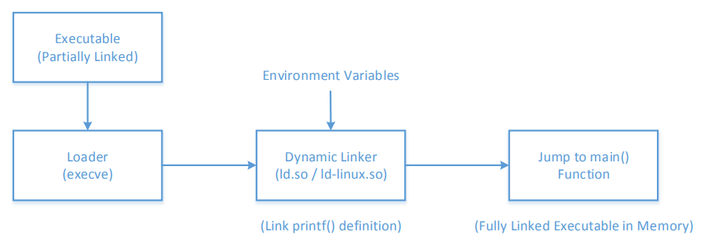
Attacks via Dynamic Linker
Dynamic Linking
The linking is done during runtime
  Shared libraries (DLL in windows)
Before a program compiled with dynamic linking is run, its executable is loaded into the memory first
Notes:
What are shared libraries?
After loading into memory, loader passes control to dynamic linker
Linker finds implementation of printf() for shared libraries
Once linking is complete the control is given to main(0

Slide 17
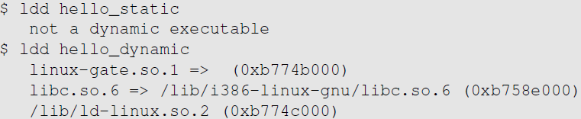
Attacks via Dynamic Linker
Dynamic Linking:
We can use “ldd” command to see what shared libraries a program depends on :
for system calls
The dynamic linker itself is in a shared library. It is invoked before the main function gets invoked.
The libc library (contains functions like printf() and sleep())

Slide 18
Attacks via Dynamic Linker: the Risk
Dynamic linking saves memory
This means that a part of the program’s code is undecided during the compilation time
If the user can influence the missing code, they can compromise the integrity of the program

Slide 19
Attacks via Dynamic Linker: Case Study 1
LD_PRELOAD contains a list of shared libraries which will be searched first by the linker
If not all functions are found, the linker will search among several lists of folder including the one specified by LD_LIBRARY_PATH
Both variables can be set by users, so it gives them an opportunity to control the outcome of the linking process
If that program were a Set-UID program, it may lead to security breaches

Slide 20
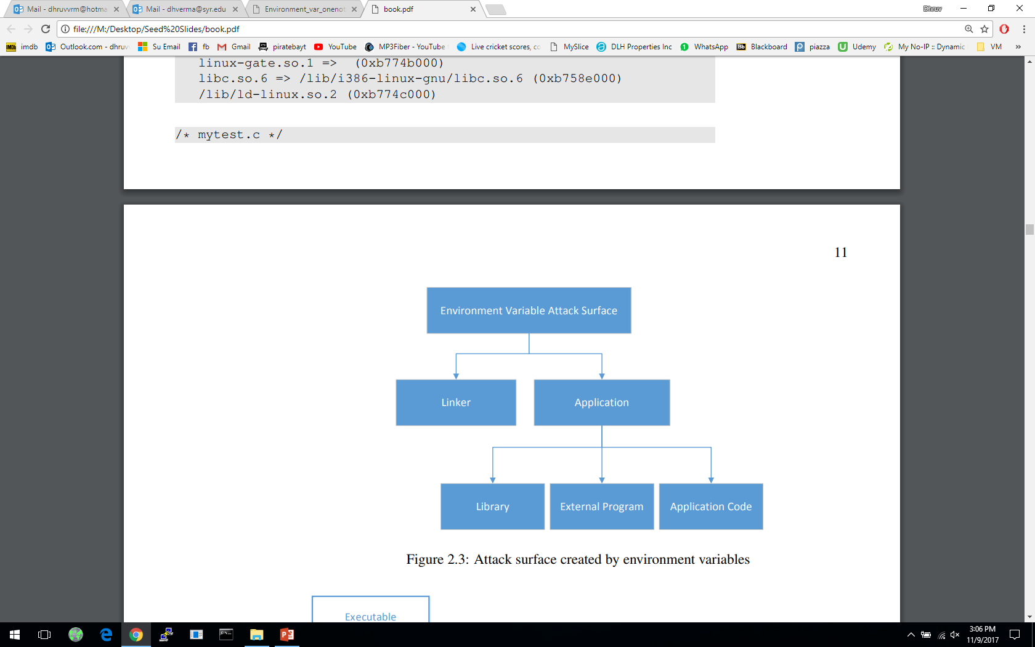
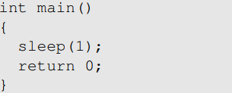
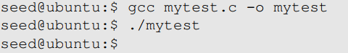
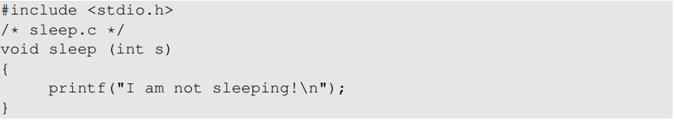
Attacks via Dynamic Linker: Case Study 1
Example 1 – Normal Programs:
Program calls sleep function which is dynamically linked:
Now we implement our own sleep() function:

Slide 21
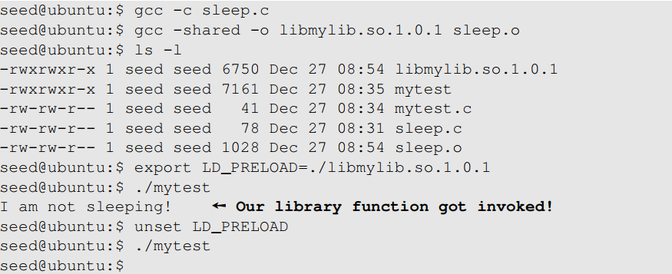
Attacks via Dynamic Linker: Case Study 1
Example 1 – Normal Programs ( continued ):
We need to compile the above code, create a shared library and add the shared library to the LD_PRELOAD environment variable

Slide 22
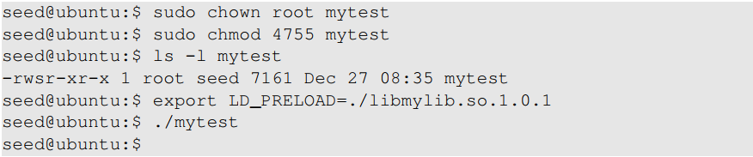
Attacks via Dynamic Linker: Case Study
Example 2 – Set-UID Programs:
If the technique in example 1 works for Set-UID program, it can be very dangerous. Lets convert the above program into Set-UID :
Our sleep() function was not invoked.
  This is due to a countermeasure implemented by the dynamic linker. It ignores the LD_PRELOAD and LD_LIBRARY_PATH environment variables when the EUID and RUID differ.
Lets verify this countermeasure with an example in the next slide.

Slide 23
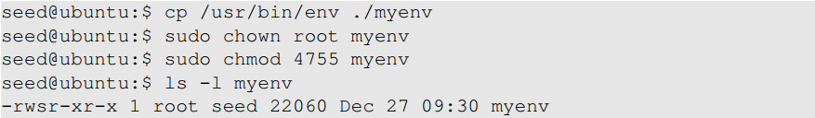

Attacks via Dynamic Linker
Let’s verify the countermeasure
Make a copy of the env program and make it a Set-UID program :
Export LD_LIBRARY_PATH and LD_PRELOAD and run both the programs:
Run the original env program
Run our env program
Notes:
Even though both the programs are identical, we see a difference.
myenv does not even display those two environment variables .
The LD_PRELOAD defined by us poses no threat.

Slide 24
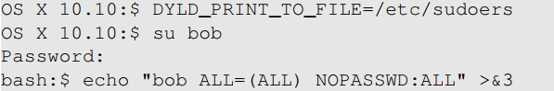
Attacks via Dynamic Linker: Case Study 2
Case study: OS X Dynamic Linker
As discussed in Chapter 1 (in capability leaking ), apple OS X 10.10 introduced a new environment variable without analyzing its security implications perfectly.
DYLD_PRINT_TO_FILE
  Ability for users to supply filename for dyld
  If it is a Set-UID program, users can write to a protected file
  Capability leak – file descriptor not closed
Exploit example:
  Set DYLD_PRINT_TO_FILE to /etc/sudoers
  Switch to Bob’s account
  The echo command writes to /etc/sudoers
Notes:
Review of the capability leaking case
Bob potentially gets access to root account

Slide 25
Attacks via External Program
An application may invoke an external program.
The application itself may not use environment variables, but the invoked external program might.
Typical ways of invoking external programs:
  exec() family of function which call execve(): runs the program directly
  system()
    The system() function calls execl()
    execl()eventually calls execve()to run /bin/sh
    The shell program then runs the program
Attack surfaces differ for these two approaches
We have discussed attack surfaces for such shell programs in Chapter 1. Here we will focus on the Environment variables aspect.
Notes:
The attack surface expands for a privileged program when they invoke an external program

Slide 26
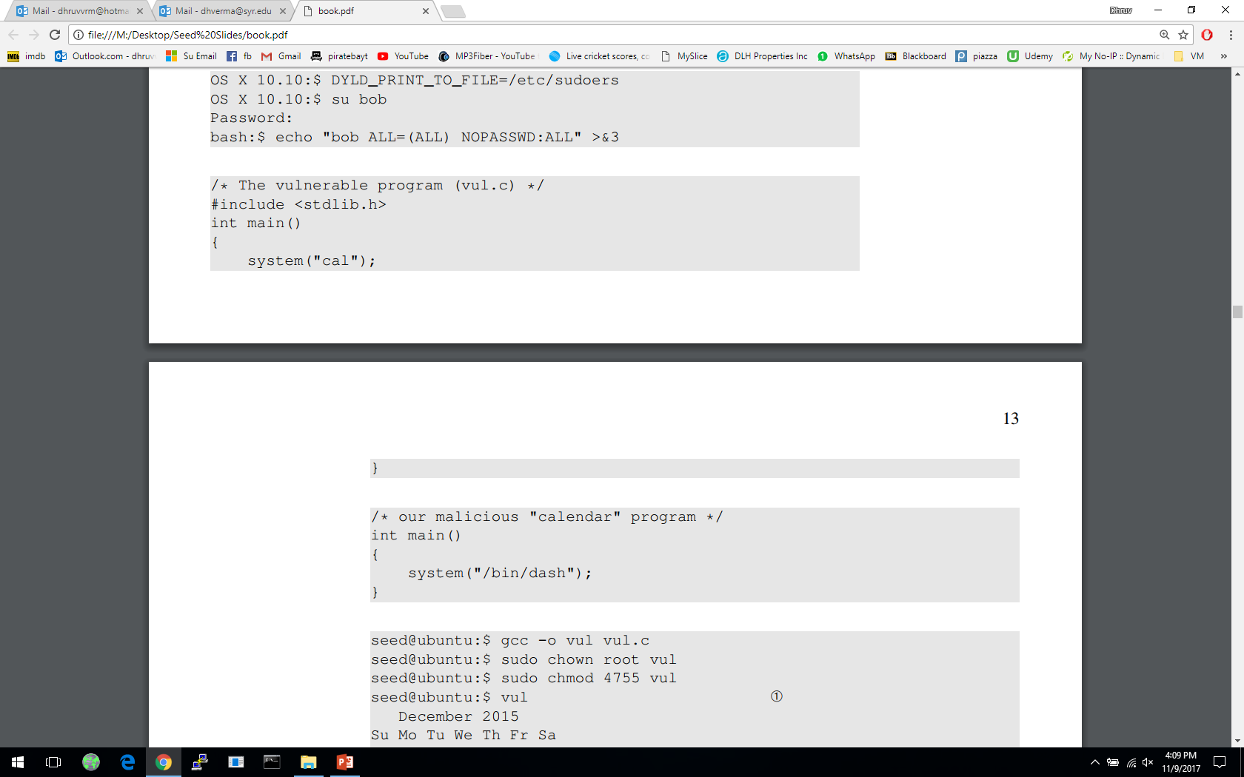
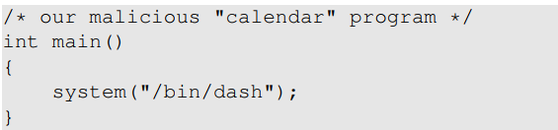
Attacks via External Program: Case Study
Shell programs behavior is affected by many environment variables, the most common of which is the PATH variable.
When a shell program runs a command and the absolute path is not provided, it uses the PATH variable to locate the command.
Consider the following code:
We will force the above program to execute the following program :
Full path not provided. We can use this to manipulate the path variable

Slide 27
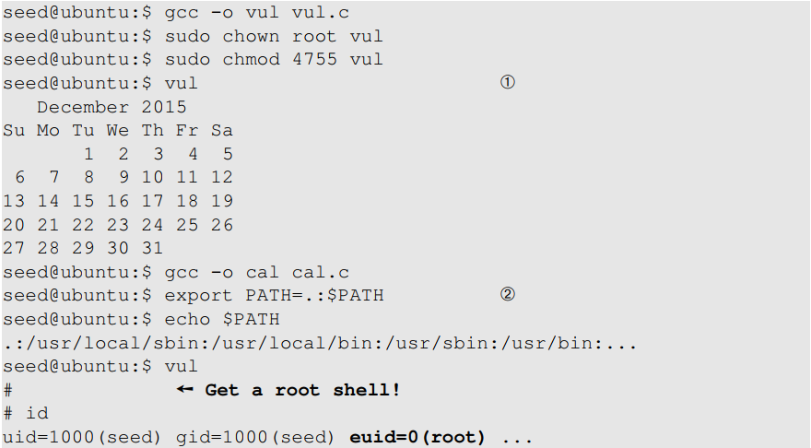
Attacks via External Program: Case Study
We will first run the first program without doing the attack
We now change the PATH environment variable

Slide 28
Attacks via External Program: Attack Surfaces
Compared to system(), execve()’s attack surface is smaller
execve() does not invoke shell, and thus is not affected by environment variables
When invoking external programs in privileged programs, we should use execve()
Refer to Chapter 1 for more information

Slide 29
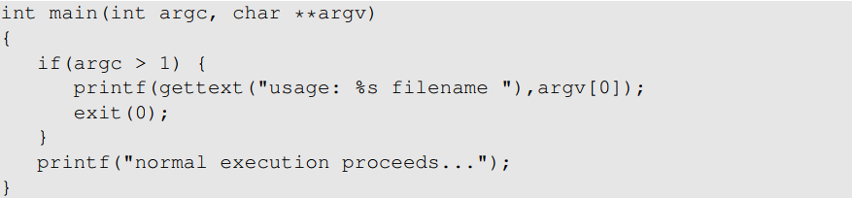
Attacks via Library
Programs often use functions from external libraries. If these functions use environment variables, they add to the attack surface
Case Study – Locale in UNIX
Every time a message needs to be printed out, the program uses the provided library functions for the translated message
Unix uses the gettext() and catopen() in the libc library
The following code shows how a program can use locale subsystem :
Notes:
What is locale subsystem?
Consists of a set of a set of databases and library functions
Store language and country specific information

Slide 30
Attacks via Library
This subsystem relies on the following environment variables : LANG, LANGUAGE, NLSPATH, LOCPATH, LC_ALL, LC_MESSAGES
These variables can be set by users, so the translated message can be controlled by users.
Attacker can use format string vulnerability to format the printf() function – More information in chapter 6
Countermeasure:
  This lies with the library author
  Example: Conectiva Linux using the Glibc 2.1.1 library explicitly checks and ignored the NSLPATH environment variable if catopen() and catgets() functions are called from a Set-UID program

Slide 31
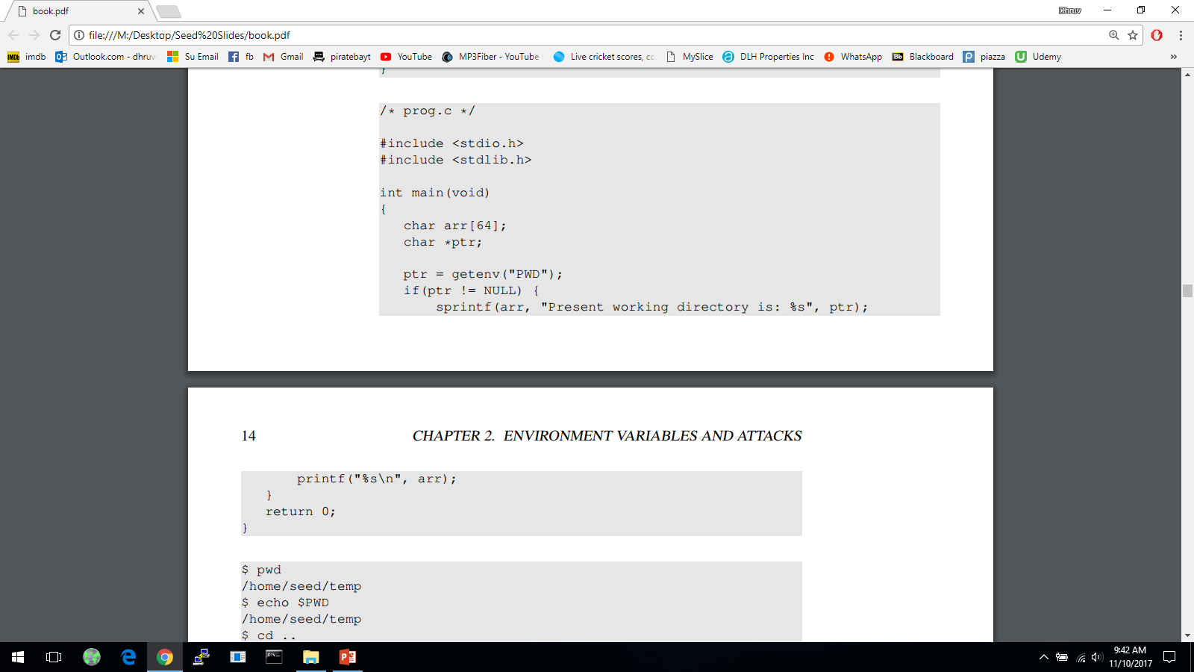

Attacks via Application Code
Programs may directly use environment variables. If these are privileged programs, it may result in untrusted inputs.

Slide 32
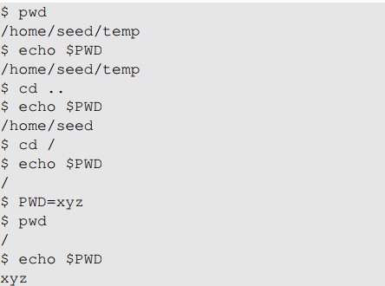
Attacks via Application Code
The program uses getenv() to know its current directory from the PWD environment variable
The program then copies this into an array “arr”, but forgets to check the length of the input. This results in a potential buffer overflow.
Value of PWD comes from the shell program, so every time we change our folder the shell program updates its shell variable.
We can change the shell variable ourselves.
Current directory with unmodified shell variable
Current directory with modified shell variable
Notes:
When a command is executed from shell, a new process will be created
The shell sets this new process’s environment variable PWD using shell variable
Hence, the value can be tampered with by the user
If this program were a Set-UID users could exploit it by setting the PWD variable to a arbitrary long string.
Attackers can further exploit the buffer overflow to gain privileges

Slide 33
Attacks via Application Code - Countermeasures
When environment variables are used by privileged Set-UID programs, they must be sanitized properly.
Developers may choose to use a secure version of getenv(), such as secure_getenv().
  getenv() works by searching the environment variable list and returning a pointer to the string found, when used to retrieve a environment variable.
  secure_getenv() works the exact same way, except it returns NULL when “secure execution” is required.
  Secure execution is defined by conditions like when the process’s user/group EUID and RUID don’t match

Slide 34
Set-UID Approach VS Service Approach
Normal-User Process
Privileged Process
Environment
Variables
Environment
Variables
Request for service
Privileged Process
(Conduct privileged operations
for users)
Privileged Process
(Conduct privileged operations
for users)
Normal User Process
(a) Set-UID Approach
(b) Service Approach

Slide 35
Set-UID Approach VS Service Approach
Most operating systems follow two approaches to allow normal users to perform privileged operations
  Set-UID approach: Normal users have to run a special program to gain root privileges temporarily
  Service approach: Normal users have to have to request a privileged service to perform the actions for them. Figure in the earlier slide depicts these two approaches
Set-UID has a much broader attack surface, which is caused by environment variables
  Environment variables cannot be trusted in Set-UID approach
  Environment variables can be trusted in Service approach
Although, the other attack surfaces still apply to Service approach (Discussed in Chapter 1), it is considered safer than Set-UID approach
Due to this reason, the Android operating system completely removed the Set-UID and Set-GID mechanism
Notes:
From the functionality perspective, Set-UID performs better. This is because it does not require a running background process.
From the security perspective, Set-UID approach has a much broader attack surface
Describe part (a) of figure in previous slide – how environment variables come from a normal process and cannot be trusted
Describe part (b) of figure in previous slide – how service is started by a privileged parent process, so the environment variables comes from a trusted source. Although attackers can still attack using other attack surfaces, there is no way for them to do it using environment variables
Android which is built on top of Linux removed the Set-UID and Set-GID mechanism

Slide 36
Summary
What are environment variables
How they get passed from one process to its children
How environment variables affect the behaviors of programs
Risks introduced by environment variables
Case studies
Attack surface comparison between Set-UID and service approaches

