Slide 1
BGP and Attacks

Slide 2
Outline
Autonomous System and ASN
Peering and Internet Exchange Point
How BGP Protocol Works
IP Anycast
BGP Attacks
How to Secure BGP

Slide 3
Introduction
For instructor: Run a traceroute from your home to your university. Ask students whether they can tell where the traffic goes. How the packets are routed depends on BGP, which is the focus of this lecture.
command: mtr -zb hostname
An example is given in the book, but it will be more interesting if you do the traceroute from your own place.

Slide 4
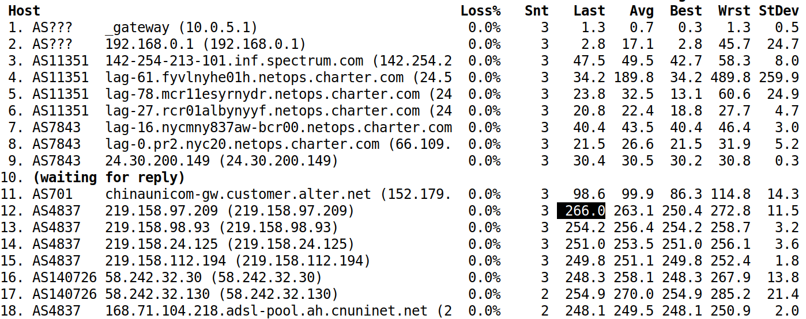
A Packet’s Journey
$ mtr -zb www.ustc.edu.cn
Notes:
To instructor: replace the target with something more meaningful to you or your students.

Slide 5
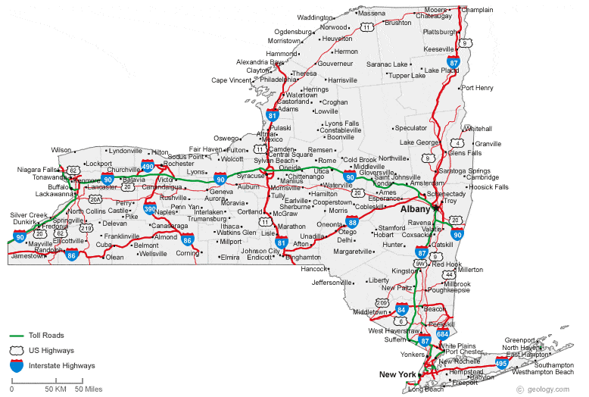
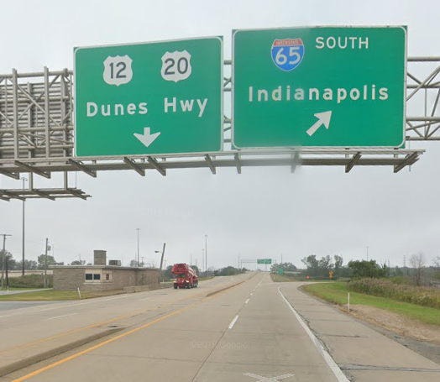
Internet Routing
How do packets know where to go?

Slide 6
High-Level Picture

Slide 7
Autonomous Systems & Peering

Slide 8
Autonomous System (AS)
Types
Stub AS
Transit AS
AS Number
Original scheme: 16 bits
Extended number: 32 bits

Slide 9
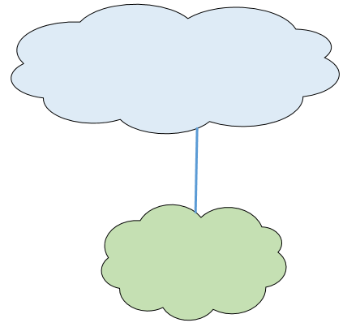
Stub AS
End customers; do not provide transit to others
AS2
AS999

Slide 10
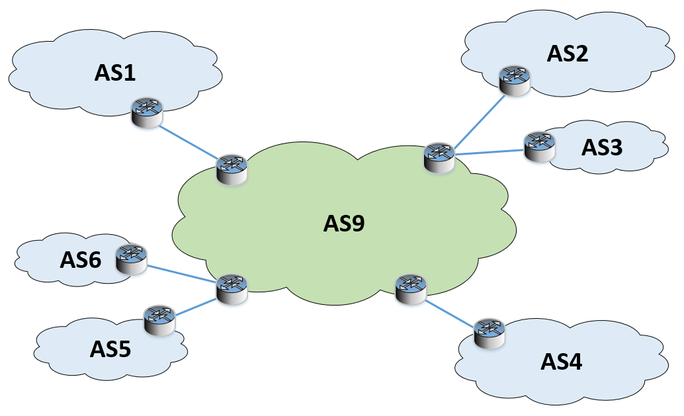
Transit AS
Provide transit to others

Slide 11
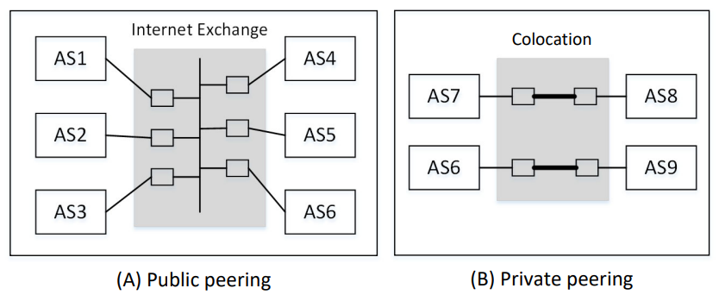
Peering
Autonomous Systems peer with one another in an Internet Exchange or a data center

Slide 12
Internet Exchange
Switch at Amsterdam Internet Exchange
source: wikipedia

Slide 13
IXP Map
Source: http://www.datacentermap.com

Slide 14
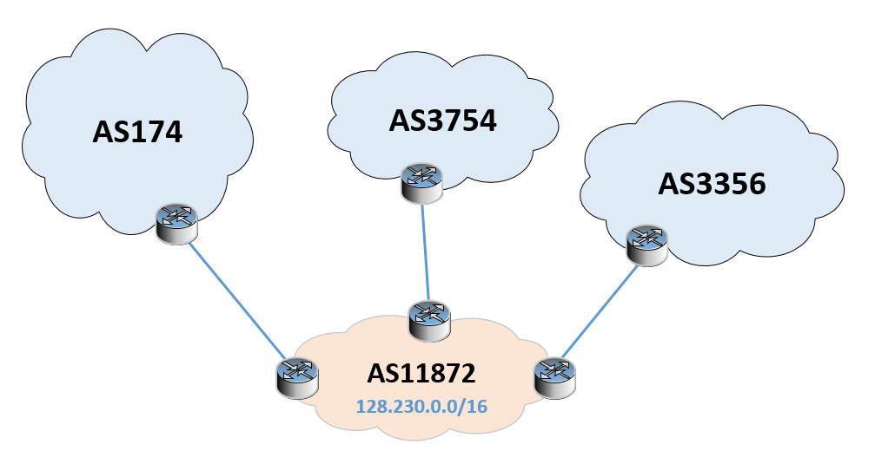
AS11872 (Syracuse University): Stub AS
URL: https://stat.ripe.net/widget/asn-neighbours

Slide 15
ASN and IP
Find ASN from IP Address
Find IP prefix from ASN

Slide 16
NYSERNET, AS3754 (Transit)

Slide 17
Cogent (AS174): National Backbone

Slide 18
How BGP Works

Slide 19
BGP Overview
EBGP (External BGP): for BGPs from different AS
IBGP (Internal BGP): for BGPs from the same AS

Slide 20
IP Prefix Announcement
Notes:
This diagram shows how the IP prefix 10.150.0.0/24 gets propagated throughout the Internet via the BGP protocol. Detailed explanation of this diagram is described in the book. It is very important for instructors to talk about each of the announcement in the class. To test how much students understand the protocol (at the high-level), instructors can remove some of the route announcement, and ask students to fill in the blank. This is a typical question that I would ask during the class, as well as in the exams.

Slide 21
Peering Sessions
AS-150 Peers with AS-2: configuration on AS-150’s BGP router

Slide 22
BGP Update Message

Slide 23
Route Advertisement
sniffing: tcpdump -nti any -vvv "tcp port 179"

Slide 24
Router Withdraw

Slide 25
TTL in BGP Packets

Slide 26
TTL Hack

Slide 27
Peering Relationship

Slide 28
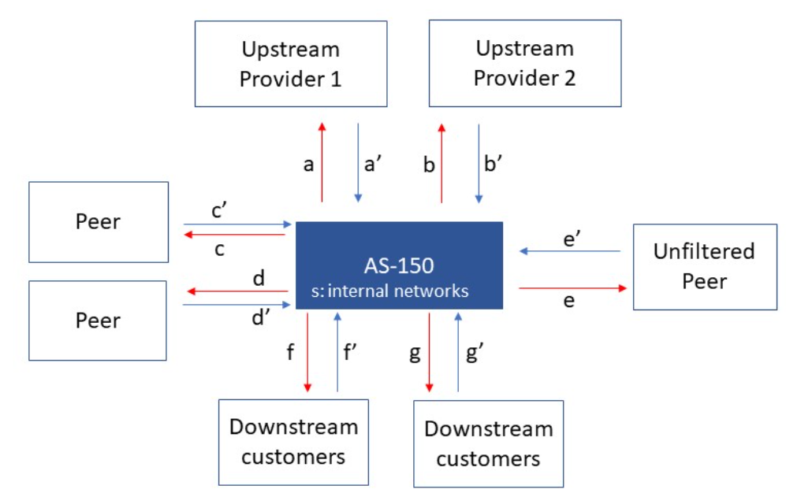
Peering Relationship

Slide 29
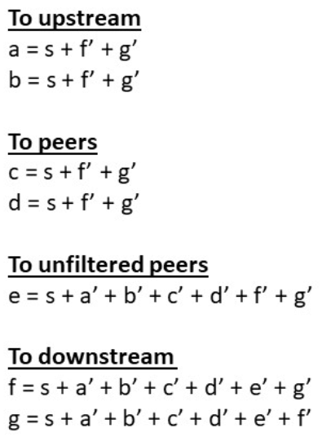
Understanding Peering Relationship

Slide 30
How BGP Implements Peering Relationship
Add attributes to routes
BGP Community
BGP Large Community
3 integers (each has 4 bytes)
ASN:Function:Parameter
In SEED Emulator

Slide 31
Filters: Peer with Provider

Slide 32
Filter: Peer with Customer

Slide 33
Filters: Peer with a Peer

Slide 34
Applications of BGP Large Community
Implementing business relationship
Enforcing security policies
Identifying routes by their geographically locations (countries, continents, etc.)

Slide 35
path selection

Slide 36
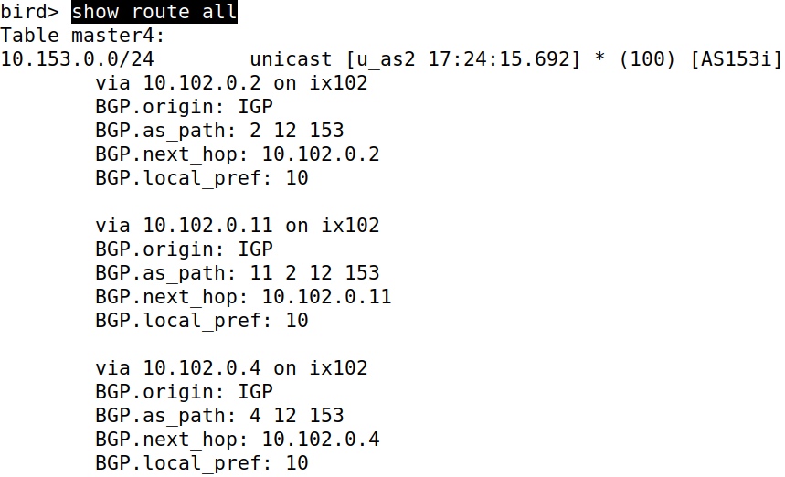
Check the BGP Routes
# birdc
BIRD 2.0.7 ready.
bird> show route all
Which route is selected?
# ip route show 10.153.0.0/24
10.153.0.0/24 via 10.102.0.2 dev ix102 proto bird metric 32
Notes:
BGP routers typically receive multiple routes to the same network.
It selects one to forward to its peers, and for its own routing

Slide 37
The Path Selection Preference

Slide 38
Local Preference: Higher Value is Preferred
Notes:
If we change the local preference of the second route from 10 to 15, the second route will be selected
Local preference is an attribute assigned to each route received
This attribute is local to AS, it does not affect other Ases
Higher value is preferred

Slide 39
Change Local Preference in the Setup

Slide 40
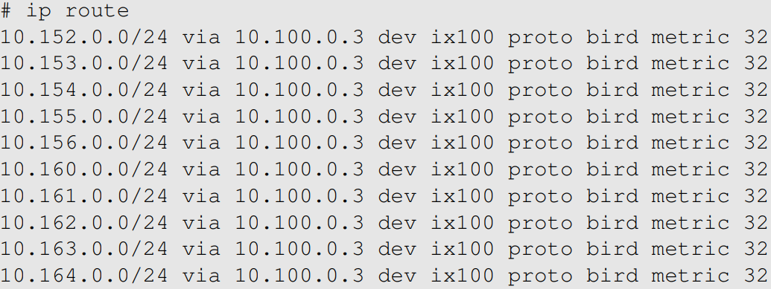
Experiment Results
(On AS-150’s BGP router)
Before the change: AS-2 is selected for most destination
(On AS-150’s BGP router)
After the change: AS-3 is selected

Slide 41
Ask Others Not to Use A Route
T’s Local preference decides how T choose a route
How can T ask its peer not to use a route?

Slide 42
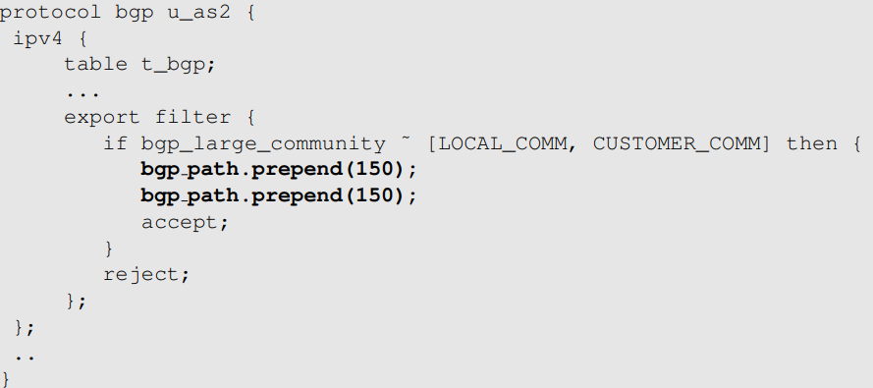
AS Path Prepending: Configuration
AS-150’s peering with AS-2

Slide 43
AS Path Prepending: Results
Notes:
The third path should have been selected if there were no path prepending, because it is shorter (the local preference values are the same)

Slide 44
IP Anycast

Slide 45
IP Anycast
Multiple machines share the same IP
Naturally supported by BGP
Routing decides which one gets the packet
Application: DNS Root servers

Slide 46
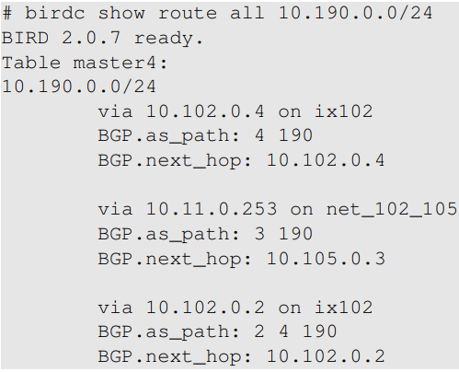
IP Anycast in SEED Emulator

Slide 47
SEED Emulator and Demo
ping 10.190.100 from
10.164.0.71
10.156.0.71

Slide 48
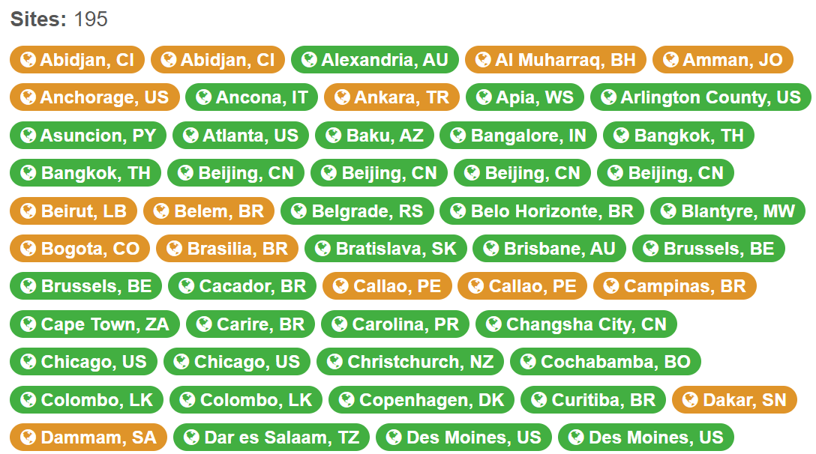
IP Anycast Used by DNS Root Server
L Root Server
l.root-servers.net
Locations
source: https://root-servers.org/

Slide 49
Question
Can we use the IP Anycast for Web servers, i.e., allowing multiple Web servers to have the same IP address, just like the F-root servers?

Slide 50
ibgp and igp

Slide 51
Internal BGP (IBGP)

Slide 52
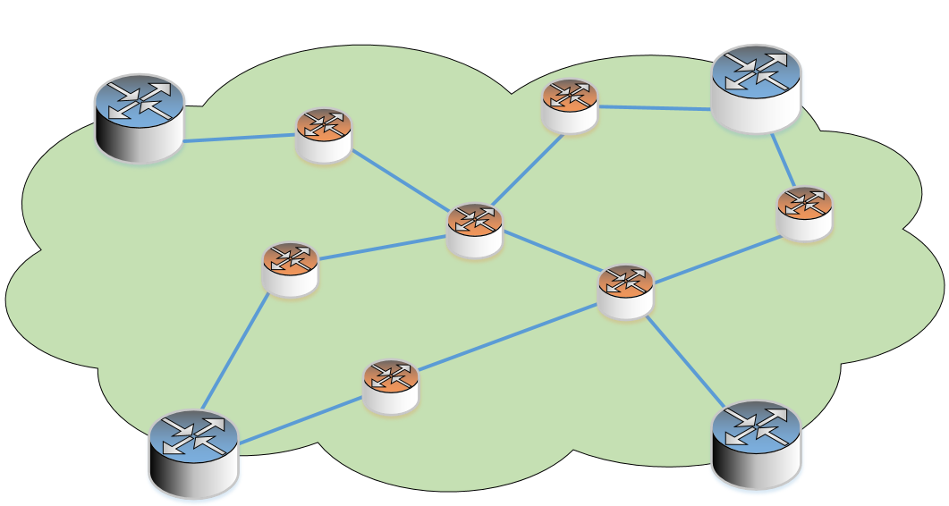
Interior Gateway Protocol (IGP)
IGP Examples
OSPF (Open Shortest Path First)
RIP (Routing Information Protocol)

Slide 53
BGP Attacks

Slide 54
BGP Hijacking Attack
BGP does not have a mechanism to verify the ownership of a network prefix
Malicious BGP routers can announce fake network prefixes

Slide 55
Routing Rule
Longest match wins
Notes:
After the new route is added, packets to 10.164.0.71 will match both 10.164.0.0/25 and 10.164.0.0/24, but the first one will be selected, because it has 25 bits of match, while the second one only has 24 bits of match.

Slide 56
Malicious BGP
How to completely hijack 10.164.0.0/24?
announce these two prefixes

Slide 57
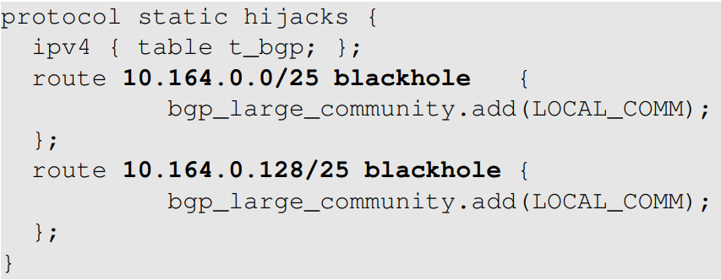
Launching the Attack
Configure AS-150’s BGP Router (attacker)

Slide 58
During the Attack
Check the Routing Tables on Any BGP router (e.g., AS151)

Slide 59
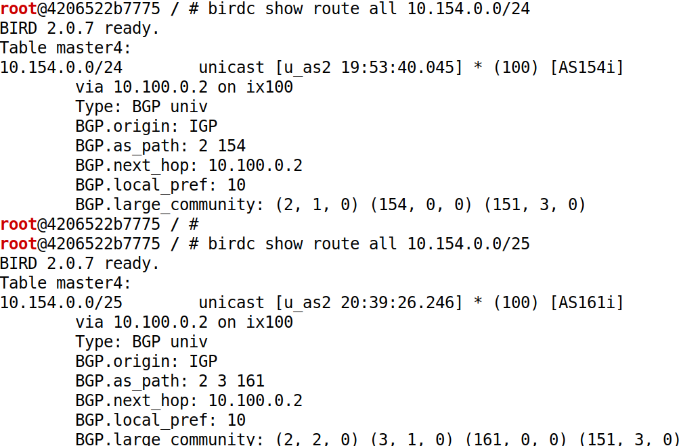
Check the BGP Table (During the Attack)

Slide 60
Fighting Back
The victim can use the same technique to fight back

Slide 61
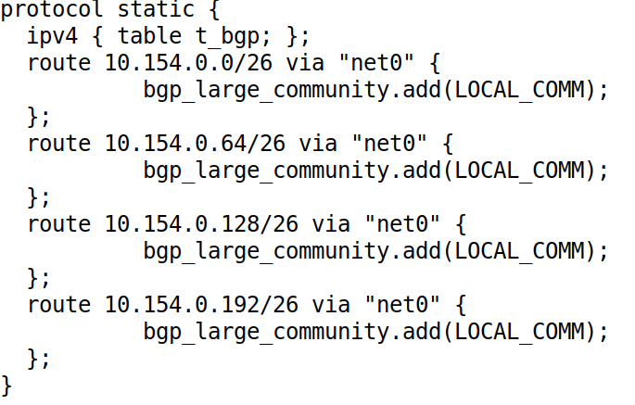
Fighting Back
Add to AS-154's BGP Configuration (Victim):

Slide 62
Fighting Back: Result
Check the Routing Tables on Any BGP router

Slide 63
Stopping the Attack
The up-stream service provider (AS-2) of the attacker can filter out the fake prefixes

Slide 64
In-Class Demo: Note to Instructors
It will be great if the instructor can do a live demo in the class, using the Internet Emulator that we build. Instructors can request a manual for this lab.
A more advanced option is to ask students to connect to the emulator via a WiFi (see our paper posted on https://seedsecuritylabs.org/emulator/). This way, students can experience the impact of the attack
Notes:
This diagram is the setup for the lab

Slide 65
In-Class Demo
Notes:
This diagram is the setup for the lab

Slide 66
BYOI: Bring Your Own Internet to Class
https://seedsecuritylabs.org/emulator/

Slide 67
Case Study: Pakistan’s Hijacking of YouTube

Slide 68
Case Study: Turkey Hijacks Global DNS Providers

Slide 69
Question
Bob failed my “Internet Security” class and got an F. He wants to blackhole my university's network (128.230.0.0/16) for revenge. Can he do that?
Notes:
This is meant to be a joke. Most students would say “Yes”, which is a “wrong” answer.
The focus of the question is on “Bob failed my class”. If he failed my class, he would not know how to do this.
Of course, technically speaking, this attack is feasible.

Slide 70
Defense
Filtering
Active monitoring
Resource Public Key Infrastructure (RPKI)
Verify the ownership of IP prefixes
Reference: RFC 7454

Slide 71
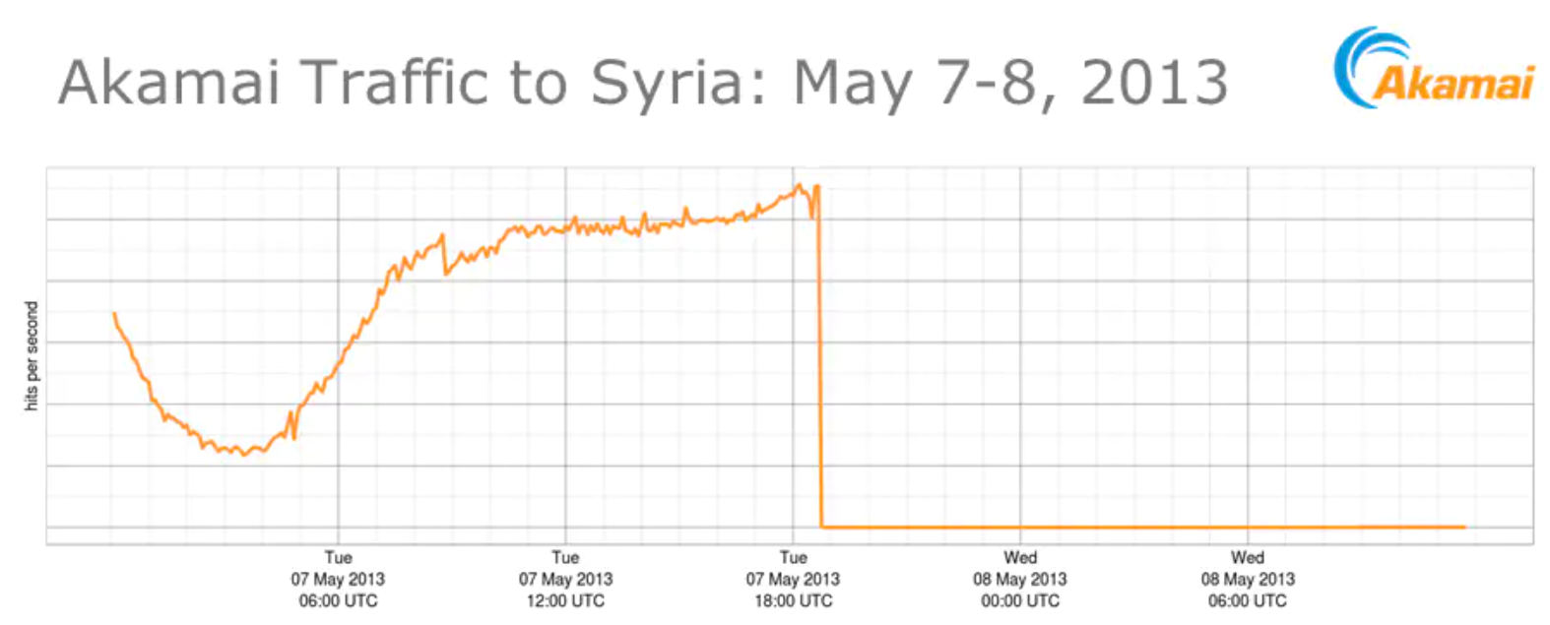
Syria Cut Off the Entire Country from the Internet?

Slide 72
Physical Attack on Internet
Ship's anchor accidentally slices Internet cable, cutting off access in six African countries
How to destroy the Internet
http://gizmodo.com/5912383/how-to-destroy-the-internet

